Slide 1
Hide and Seek

Slide 2
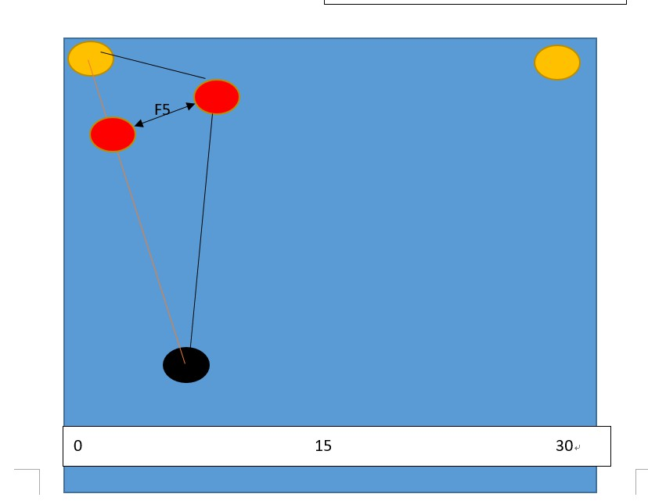

Weighting
Police feature
f1 : constant
f2 : the minimum distance to the two outlets
f3 : x coordinate
f4 : y coordinate
f5 : The vertical distance from the police to the line between the thief and the exit

Slide 3
Weighting
Thief feature
f1 : constant
f2 : the minimum distance to the two outlets
f3 : x coordinate
f4 : y coordinate
f5 : the number of stay on the pressure plate

Slide 4
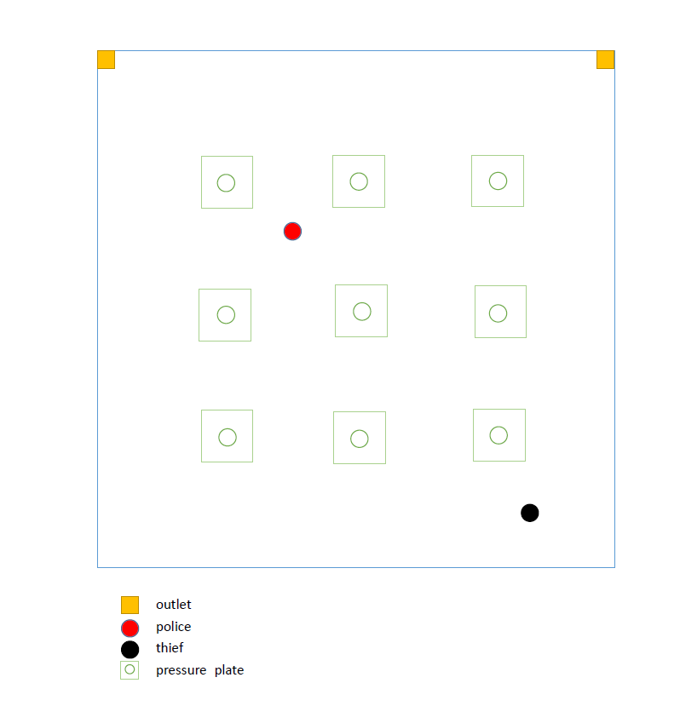
map

Slide 5
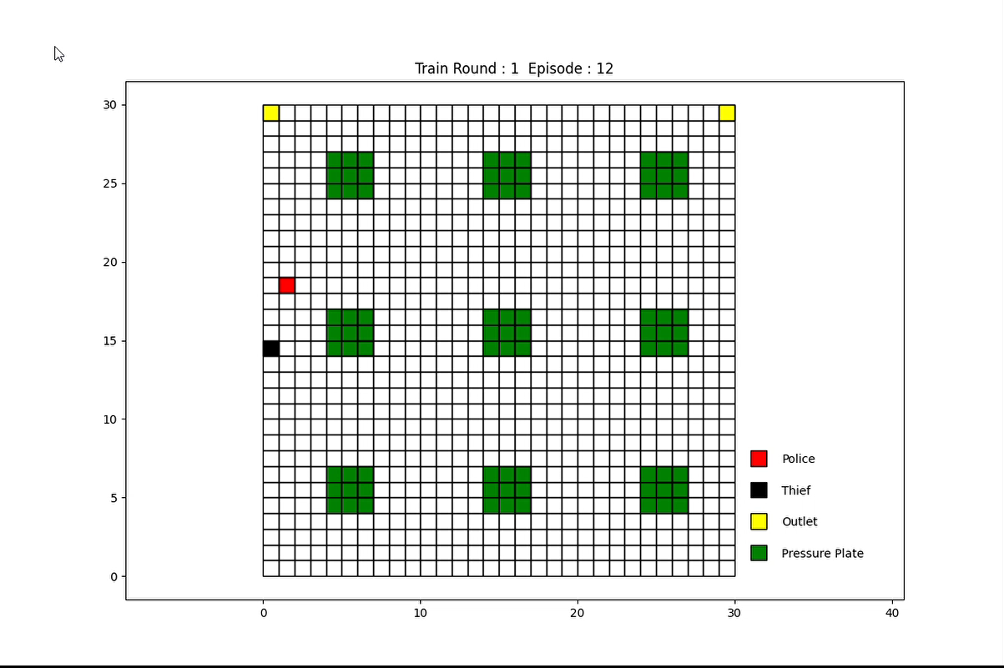

Slide 6
Problem
Pressure plate
Simulation

